Slide 1
Breast Cancer Knowledge, Attitudes, and Practices (KAP) study in Jordan

Slide 2
Background
  Breast Cancer is the most common cancer among women worldwide. It is among the most common causes of women morbidity and mortality.
  It is responsible for approximately 23% of all new cancer cases and 14% of total deaths around the world.
  Women in LMICs account for 53% of new breast cancer cases
  44,849 new breast cancer cases in 2020 in the Middle East.
  Early detection of breast cancer leads to better prognosis and lower mortality rates
  LMICs approach to breast cancer screening needs to be both strategic and realistic.

Slide 3
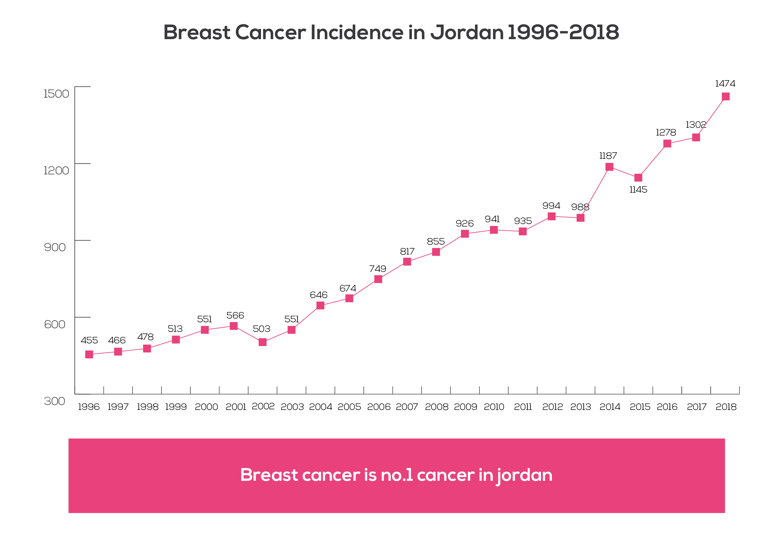
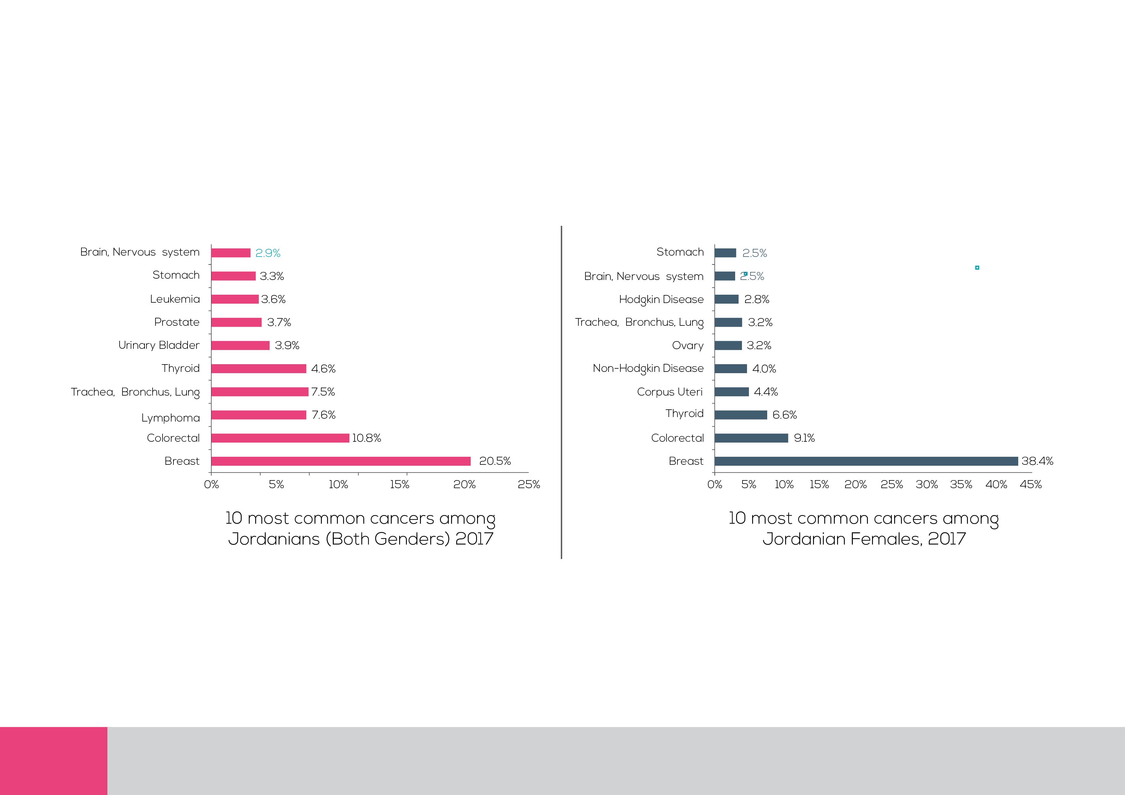
Background: Breast Cancer in Jordan:
Most of the women diagnosed in Jordan are between the ages of 40-59 years.
The median age of diagnosis is 10 years younger than western countries (Median age is 52).
Jordan’s National Guideline for breast cancer early detection recommends BSE every month starting at the age 25, CBE annually above 25 years, & mammography once every 1-2 years above 40 yo.

Slide 4

Respondents’ Demographics
100%
Females
RESPONDENTS’ Education
Marital Status
Cross-sectional
A sample of 2058 women across Jordan
Structured questionnaire Interview length 30-35 minutes
Data was collected using Computer-Assisted Personal Interviews (CAPI)
Interviewer administered survey
BASE: 2,058

Slide 5
Findings

Slide 6
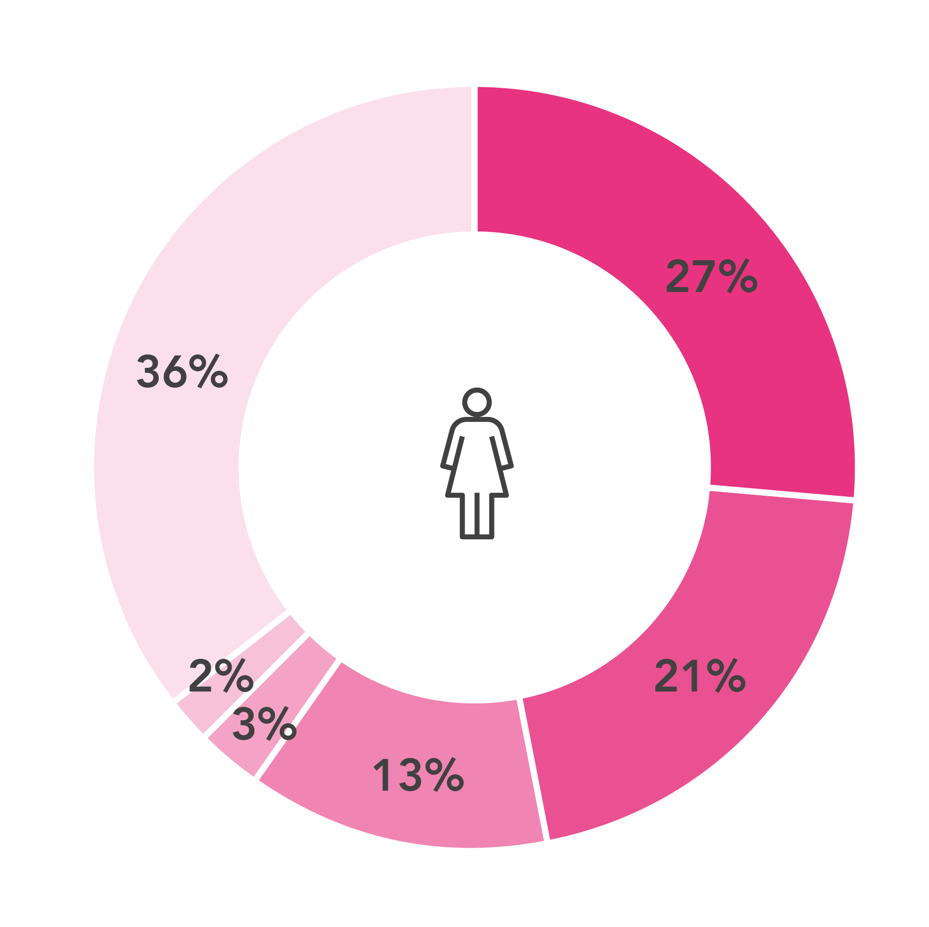
Spontaneous Health Condition Indicates Women Attention to the Health Issue
OTHERS
Other Cancer Types | 9%
Obesity | 5%
Gynecological diseases | 2%
Anemia | 2%
Coronavirus | 1%
Infections | 1%
Thyroid | 1%
Strokes | 1%
Joints Pain | 1%
Disc | 1%
Headache | 1%
Colon | 1%
NONE | 4%
Others | 7%
Breast cancer
Heart diseases
Diabetes
Cervical Cancer
Blood Pressure
Others
HEALTH CONDITION
OF CONCERN
BASE: 2,058
عند التفكير بالحالات الصحية التي تصيب السيدات ما هي الحالة الصحية التي تخطر على بالك أولاً وتجعلك أكثر حرصا على متابعة صحتك؟

Slide 7
Perceptions on most serious cancer
By far, respondents consider Breast Cancer as the most common and serious cancer affecting women’s health
Top of Mind Answer
Most Common and
serious to Women
BASE: 2,058
فيما يتعلق بأنواع السرطانات المختلفة التي انت على دراية بها، من فضلك أخبريني ما نوع السرطان الذي برأيك الذي يعتبر الاكثر انتشارا وعرضة للإصابة لدى السيدات

Slide 8
Knowledge on Breast Cancer Symptoms (TOTAL)

Slide 9
Knowledge on Breast Cancer Risk Factors (Total)

Slide 10
Breast Cancer Early Detection Tests

Slide 11
Knowledge Vs Practice of Early Detections Exams

Slide 12
Awareness of Beast Cancer Exams (Aided)
  Percentage of respondents who don’t know breast cancer tests was highest in the age group (40-44 yrs.) and (50-54 yrs.), 25-29 Age group was the highest group scored the lowest awareness on Mammogram as well. The lowest awareness on mammogram was seen in Irbid, Mafraq, and Maan
 | 20-24 yrs. | 25-29 yrs. | 30-34 yrs. | 35-39 yrs. | 40-44 yrs. | 45-49 yrs. | 50-54 yrs. | 55-59 yrs. | 60-64 yrs. | 65-69 yrs. |  | Amman | Balqa | Zarqa | Madaba | Irbid | Mafraq | Jerash | Ajloun | Karak | Tafileh | Ma’an | Aqaba
Base | 373 | 320 | 300 | 272 | 227 | 192 | 145 | 101 | 70 | 58 |  | 526 | 148 | 280 | 87 | 325 | 164 | 99 | 88 | 121 | 66 | 73 | 81
Biopsy | 72% | 72% | 67% | 70% | 68% | 72% | 72% | 75% | 73% | 67% |  | 73% | 70% | 74% | 82% | 62% | 74% | 71% | 73% | 77% | 70% | 56% | 62%
Ultrasound | 42% | 42% | 46% | 49% | 44% | 43% | 41% | 52% | 50% | 31% |  | 50% | 55% | 40% | 48% | 38% | 36% | 34% | 52% | 48% | 50% | 29% | 43%
CBE | 38% | 33% | 37% | 35% | 36% | 46% | 37% | 41% | 41% | 36% |  | 40% | 43% | 36% | 39% | 38% | 38% | 31% | 40% | 34% | 23% | 29% | 33%
SBE | 32% | 34% | 28% | 30% | 23% | 28% | 24% | 34% | 26% | 22% |  | 30% | 28% | 28% | 29% | 27% | 24% | 31% | 32% | 36% | 36% | 27% | 22%
Mammogram | 21% | 19% | 25% | 31% | 26% | 20% | 20% | 25% | 27% | 21% |  | 26% | 24% | 25% | 30% | 19% | 18% | 21% | 33% | 26% | 20% | 16% | 21%
Don’t Know | 6% | 5% | 6% | 7% | 9% | 5% | 8% | 6% | 7% | 5% |  | 5% | 5% | 6% | 2% | 8% | 7% | 12% | 3% | 3% | 6% | 14% | 12%
Others | 1% | 3% | 1% | 1% | 1% | 1% | 3% | 0% | 1% | 5% |  | 0% | 4% | 2% | 0% | 2% | 1% | 1% | 1% | 1% | 3% | 5% | 0%
من هذه القائمة، ما هي طرق تشخيص سرطان الثدي التي أنت على دراية بها للكشف المبكر عن سرطان الثدي

Slide 13
Practices of SBE
  With regards to SBE practices, (33%) mentioned that they do the SBE on a monthly basis, while (43%) they do not do the SBE. Most common reason for doing the SBE was for “check up”
Frequency of doing the SBE
Reasons of doing the SBE in the specific frequency
Avg. Age of which respondents think that they should start SBE is
25.9 Years
BASE: 1,601
ما تكرار قيامك بالفحص الذاتي للثدي؟
ما هي الأسباب التي تجعلك تقومين بالفحص بهذا التكرار
BASE: 958

Slide 14

Practices of CBE
The most recorded reason of which respondents did the CBE, was because of symptoms appeared
And 35% of respondents who have done the CBE, said that doctor did not recommend any actions based on the CBE
Ever done
CBE
Reasons for
doing the CBE
Doctor’s
Recommendations
BASE | 572
Symptoms appeared | 57%
Just a check up | 35%
Others (Specify) | 12%
Recommendation from doctor | 10%
Recommendation from people surrounding me | 2%
Reached an age where I am supposed to do the CBE | 1%
JBCP lectures | 1%
Lectures | 1%
Avg. Age of which respondents think that they should start CBE is
29.2 Years
هل سبق لك وقمتي
بالفحص السريري للثدي؟
ما هي الأسباب التي جعلتك تقومين
بالفحص السريري للثدي أخر مرة؟
ما هي توصيات الطبيب لك
حسب أخر الفحص السريري للثدي
BASE: 1,659
BASE: 572

Slide 15
Barriers of doing CBE
When asked about the barriers of not doing the CBE, the majority reported that it is because no signs of breast cancer appeared
BASE: 1,087 those who has never done CBE
ما هي الأسباب التي منعتك من إجراء الفحص السريري للثدي؟

Slide 16
Knowledge and Practice on Mammography Screening
Perception on the age to do the Mammogram
Frequency should a woman do the Mammogram by
Total interviews | 982
As of the age of 40 yrs. | 44%
Before the age of 40 yrs. | 34%
Other than that | 14%
I do not know | 7%
Total interviews | 982
Yearly | 53%
Every two years | 4%
Every 4 years | 1%
Never | 0.5%
I do not know | 11%
Others, specify | 30%
ما هو السن الملائم لإجراء فحص الثدي بالأشعة (الماموغرام) إذا لم يكن هناك تاريخ مرضي لسرطان الثدي؟
ما هو المعدل الذي يجب فيه على النساء إجراء فحص الثدي بالأشعة (الماموغرام)؟

Slide 17
Reasons which make women
do the Mammography
Ever done mammogram
in the past 5 years
Majority of “Others” is JUST FOR CHECK UP
ما الأسباب التي تجعل النساء تقوم بفحص الثدي بالأشعة (الماموغرام)؟
كم مرة قمت بعمل فحص الثدي بالأشعة (الماموغرام) خلال الخمس سنين السابقة؟
BASE: 982

Slide 18
Experience with mammography
# of mammogram done
in the past 12 months
Reasoning of doing the last mammogram
Challenges
faced
BASE | 152
Symptoms appeared | 51%
Just a check up | 36%
Recommendation from doctor | 24%
Others (Specify) | 9%
Reached an age where I am more vulnerable to breast cancer | 3%
Recommendation from people surrounding me | 3%
Lectures | 1%
JBCP lectures | 1%
Base = 152 Those who have done the exam in the past 5 years
Base = 152 Those who have done the exam in
the past 5 years
هل قمتي خلال 12 أشهر السابقة بعمل فحص الثدي
بالأشعة (الماموغرام
لماذا قمتي بعمل فحص الثدي بالأشعة
(الماموغرام) في أخر مرة؟
من فضلك أخبريني ما هي التحديات التي واجهتها عند
اجراء فحص الثدي بالأشعة (الماموغرام)؟ ماذا أيضاً؟

Slide 19
Challenges faced when doing
the Mammography
Barriers for not doing the
mammography
 | Below 40 Yrs. | 40 Yrs. And Above
BASE | 37 | 115
NONE | 35% | 38%
Fear of Results | 30% | 12%
Painful | 27% | 42%
Expensive | 8% | 3%
No close health care centre which provides Mammography | 8% | 0%
Difficult procedures at the exam centers | 8% | 4%
Awareness of screening centers’ locations and service availability | 3% | 0%
It takes time | 0% | 3%
Knowing how to do the exam | 0% | 1%
Others | 16% | 10%
  Mammogram is not linked to screening and early detection habits by most of the respondents
BASE | 303
No symptoms appeared | 64%
Fear of results | 15%
Cost | 9%
Time limitations | 8%
No close health care centre which provides Mammography | 3%
I have other financial priorities | 1%
I don’t know anything about it | 1%
It takes time | 1%
Painful | 1%
Others (specify) | 18%
BASE: +40 yrs.
ما الأسباب التي لا تجعلك من القيام فحص الماموغرام لكشف المبكر؟ ماذا أيضاً؟

Slide 20
Awareness on Where it can be done
  It is noticed that respondents see multiple health institutions can do the mammogram, with the highest be for Public Hospitals
Total interviews | 152
Public Hospitals | 51%
Private Hospitals | 39%
MOH Public Health Centers | 25%
Military Hospitals | 25%
King Hussein Cancer Center | 24%
Private Health Centers / Radiology | 16%
Others (Specify) | 7%
Don’t Know | 1%
Base: Those who have done the mammogram screening
في أي جهات / مؤسسات صحية يمكن اجراء فحص الثدي بالأشعة (الماموغرام)

Slide 21
Attitudes & Future Practices

Slide 22
Physicians
PHYSICIAN’S RECOMMENDATION ON DOING BREAST SCREENING
Perceptions on the physician to see (by specialty) if a breast cancer case was suspected
هل سبق ونصحك طبيبك بعمل فحوصات الكشف المبكر لسرطان الثدي بشكل اعتيادي للاطمئنان فقط
إذا اشتبهت المرأة في اصابتها بسرطان الثدي، من هو الطبيب
المختص الذي يجب أن يستشيره؟
BASE: 2,058

Slide 23
Perceptions on the motivating factors for screening
SBE
CBE
Mammogram
BASE | 1,659
Increase awareness | 49%
When symptoms appear | 32%
Lower the cost or make it free | 12%
Encouragement from family members | 11%
Do not know | 7%
Closeness of exams centers | 5%
Ensure doctors are recommending the early screening to women | 4%
Facilitate procedures / appointments | 2%
Qualified medical staff | 2%
To be included in the insurance | 1%
Others | 15%
BASE | 1,691
Increase awareness | 66%
When symptoms appear | 13%
Encouragement from family members | 8%
Do not know | 7%
Ensure doctors are recommending the early screening to women | 3%
Lower the cost or make it free | 3%
Closeness of exams centers | 2%
To be included in the insurance | 1%
Qualified medical staff | 1%
Facilitate procedures / appointments | 1%
Others | 21%
BASE | 982
Increase awareness | 38%
When symptoms appear | 36%
Lower the cost or make it free | 17%
Encouragement from family members | 9%
Do not know | 8%
Ensure doctors are recommending the early screening to women | 6%
Closeness of exams centers | 5%
Facilitate procedures / appointments | 3%
To be included in the insurance | 2%
Qualified medical staff | 1%
Others | 15%
ما الأمور التي تعتقدي أنها من الممكن أن تشجع النساء بالقيام بفحوصات الكشف المبكر عن سرطان الثدي بشكل منتظم

Slide 24
Screening plans
Planning to do the early screening in the next 12 months on a regular basis
Early detection tests in
consideration
خلال ال 12 أشهر القادمة، هل تخططين لعمل فحص دوري للكشف المبكر عن سرطان الثدي (بدون أعراض) بشكل منتظم؟
ما أنواع فحوصات `الكشف المبكر التي ستأخذينها بعين الاعتبار؟
BASE: 2,058
BASE: 1,107

Slide 25
Intension to Conduct Early Detection Exams
Variable | n | %
Early Detection Exam( n=2058)
Yes | 1,107 | 53.8
SBE (n=1107)
Yes | 559 | 50.5
CBE (n=1107)
Yes | 575 | 51.9
Mammogram (n=1107)
Yes | 159 | 14.4
Mammogram whom were 40 and above (n=417)
Yes | 96 | 23.02

Slide 26
Conclusion
  Knowledge among Jordanian women about breast cancer is relatively good compared to previous similar studies (KAP 2015). However, practice is not to an optimal level expected.
  Absence of symptoms, fear and cost of mammograms are among the most reported barriers; thus, action should be made to address these barriers.
  Efforts should continue to be holistic, to address barriers both behavioral related and health system related barriers.

Slide 27
THANK YOU

